Slide 1
Vienna Scientific Cluster A joint High Performance Computing Facility of Austrian Universities
Ernst Haunschmid, TU WIEN
EOSC, 30th October 2018

Slide 2
Vienna Scientific Cluster
Besides Theory and Experiment numerical Simulation has become a third pillar in science.
VSC satisfies the high performance computing needs of scientist from all universities with the joint project

Slide 3
The first 10 Years
Collaboration established 2008
VSC-1 installed 2009
Ranked #156 in Top500
32 Tflop/s
VSC-2 installed 2011
Ranked #56 in Top500
150 Tflop/s
New partners in 2013
VSC-3 Installed in 2014
Ranked #85 in Top500
Ranked #86 in Green500
600 Tflop/s
More partners in 2016
VSC-4 awarded end of 2018
About 2.000 Tflop/s

Slide 4
Organization
Governance:
Steering Committee advices rectorates of member universities
decides on project applications and grants resources.
Coordination between partners
VSC is not a legal entity
Finance:
From the Federal Ministry of Science, Research and Economy via the budget of the member universities.
Additional funding via HRSM projects
Pay per use for other research oriented partners (e.g. eodc)
Operation:
TU Wien has been assigned to operate the VSC systems
VSC Team supports user community
Notes:
No legal entity
VSC-team

Slide 5
VSC-2
Installed Summer 2011
1220 AMD Opteron nodes
Mellanox QDR Infiniband
Air cooled
Water cooled rear doors
20 °C water input temperature
18 °C in the outer loop
Hybrid cooling system
free-cooling (up to 15°C)
chiller based cooling

Slide 6
VSC-2 Power consumption

Slide 7
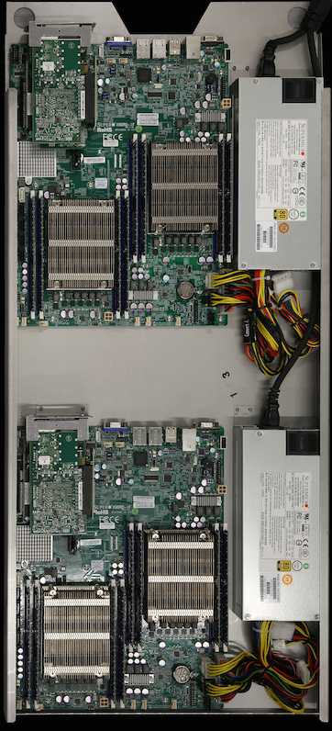
VSC-3
VSC-3 optimized for performance and efficiency
Installed Summer 2014
2020 Supermicro based compute nodes
Intel E5-2650 v2 (8 cores, 2.6 GHz)
64 GB main memory
Two Intel QDR Infiniband HCAs
Intel dual-rail QDR Infiniband
Fabric is segmented into 8 islands
each about 4500 cores
Immersion cooling

Slide 8
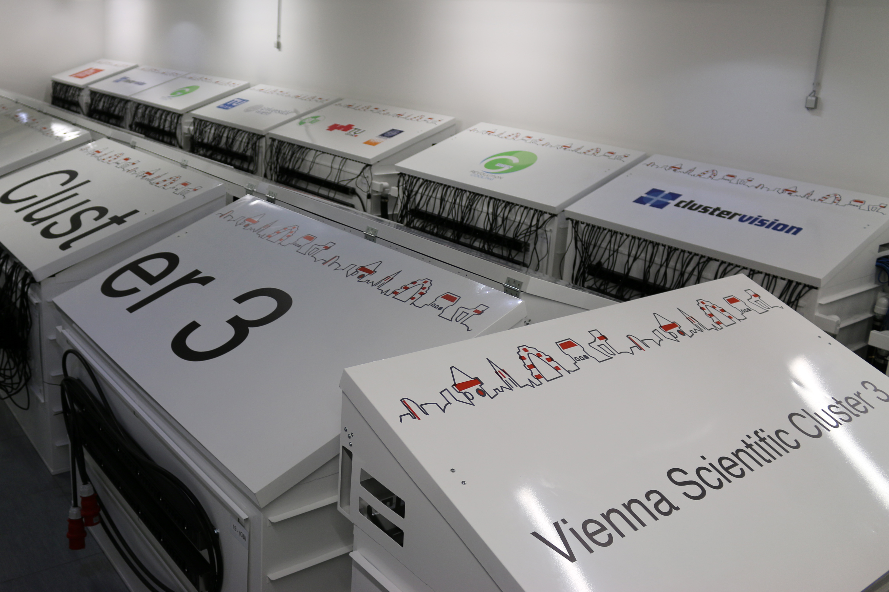
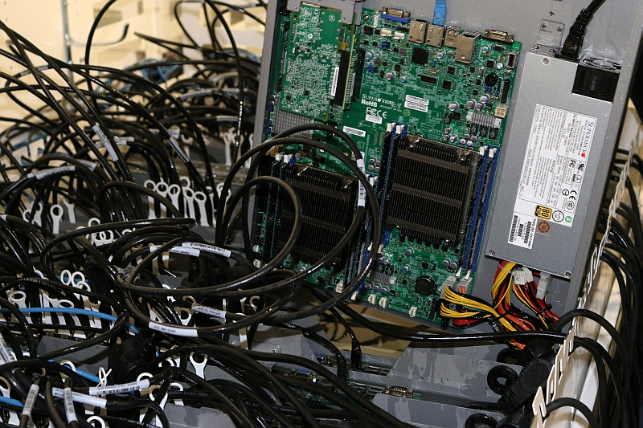
VSC-3 Cooling
Oil based immersion cooling
Provided by Green Revolution Cooling (GRC), Texas based
More than 32.000 liters of white mineral oil
Pump modules (PM) under the raised floor, heat transfer into water loop
No room (air) cooling
Room temperature up to 45 °C
Infiniband core rack air cooled
Free cooling all over the year
Cooling overhead less than 3%
State of the art energy efficiency
Storage is located in nearby room

Slide 9
Science at VSC
The VSC is primarily devoted to research
Projects are peer reviewed
either by a funding agency (preferred)
or by reviewers appointed by the steering committee
Publications and Projects are publicly visible at our web site.
More than 900 publications in scientific journals
300 active projects with 1200 users
900 projects since 2009

Slide 10
Challenges
New topics
Big data, data analytics, real time data
Machine learning, artificial intelligence
Empower scientists
computation resources and data storage
Support scientific projects with new tools and methods
Collaboration and partnership
Interoperability

Slide 11
Thank You for Your Attention

