Slide 1
Digital Humanities in Austria Transkribus A European research infrastructure for the automated recognition and searching of historical documents
Günter Mühlberger
University Innsbruck,
Digitisation and Digital Preservation Group

Slide 2
Agenda
Overview on DH
READ
Handwritten Text Recognition
Sustainability

Slide 3
Digital Humanities in Austria
Austrian Centre for Digital Humanities (ACDH)
Common effort of the Austrian Academy of Science, Universities of Vienna and Graz as well as several other universities and colleges in Austria
Acts also as CLARIAH centre at the Austrian Academy of Science
Universities of Vienna and Graz
Three DH professorships
Master studies in DH at University Graz
National projects
Digital Edition Network (KONDE)
DI4DH (Digitisation and Information Extraction for DH)
GoDigital calls
Large number of research projects
Highly active and lively landscape!
Hundreds of researchers involved

Slide 8
…and many, many more

Slide 9
Many of these DH projects have one thing in common – they are working with historical documents and need to digitise, transcribe, annotate, search and mine the text

Slide 11
Consortium
University Innsbruck (Coordinator / Austria)
Technical University Valencia (Spain)
University College London (UK)
National Center for Scientific Research “Demokritos” (Greece)
University of London Computer Centre (UK)
Technical University Vienna – Computer Vision Lab (Austria)
University Rostock (Germany)
University Leipzig (Germany)
Naver Labs (France)
Technical University Lausanne (Schwitzerland)
National Archive Finland (Finland)
Statearchive Zurich (Switzerland)
Passau Diözesanarchiv (Germany)
Democritus University Thrace (Greece)

Slide 12
READ - Transkribus
Facts and figures
Horizon 2020 eInfrastructure Project
8,2 mill. EUR funding
Duration: 1.1.2016 – 30.6.2019
14 partners, coordinated by the University of Innsbruck
Research infrastructure
Digitisation, transcription, recognition, search in historical documents
Cover the complete workflow so that users need no other tools to come from images to fully functional text
Culture of collaboration
Foster cooperation between all stakeholders in the field: archives/libraries, humanities scholars, computer scientists and public users (volunteers)
Open Access
Share research and data but enable users to work in a private environment

Slide 13
ARCHIVES
LIBRARIES
Digitized documents
Recognized documents
Domain knowledge
TRANS-
KRIBUS
Data
Competitions
HUMANITIES
SCHOLARS
STORAGE
COMPUTER SCIENTISTS
&
TECHNOLOGY PROVIDERS
EXPERT
INTERFACE
TRAINING
RECOGNITION
SEARCH
Results
Technology
WEB INTERFACE
Digitize
Search
Contribute
Improved
services
PUBLIC
VOLUNTEERS

Slide 14
Memorandum of Understanding Partners
Australia
Geopast
National Library of Australia
Austria
University Vienna, German Studies Department
Technical University Graz – University Archive
Canada
DEEDS Project – University of Toronto
Denmark
Aarhus City Archives
Finland
Finnish Literature Society
The Society of Swedish Literature in Finland
Tampere University Folklife Archives

Slide 15
France
ALMAnaCH – Inria Paris Research Centre
National Library of France
Germany
Deutsche Zentralbibliothek für Medizin
Ernst-Moritz-Arndt-University of Greifswald
Fernuniversität Hagen – Department for History and Biography
Friedrich-Alexander-Universität Erlangen-Nürnberg – Pattern Recognition Lab
Germanisches Nationalmuseum
Gottfried Wilhelm Leibniz Bibliothek
Heidelberg University, Department of History
The Hessian State Archives
Institute for Documentology and Scholarly Editing
Museum for Musical Instruments of Leipzig University
PLANET

Slide 16
University and Research Library Erfurt/Gotha
Hochschule Hanover – University of Applied Sciences and Arts
Österreichischer Bibelübersetzer – Bavarian Academy of Science at the University of Augsburg
University Library Tübingen
University of Rostock – Edited Letters – Barlach 2020
University of Rostock Library
Greece
National Bank of Greece Cultural Foundation
Italy
Archivo Storico Ricordi
BOhisto – The Civic Archives of Bozen-Bolzano
Marciana National Library
Luxembourg
Centre virtuel de la connaissance sur l’Europe – Digital Humanities Lab

Slide 17
Netherlands
Center for Global Heritage and Development (Leiden University, Erasmus University Rotterdam, Delft University of Technology)
Cultural Heritage Agency
Huygens Institute for the History of the Netherlands
International Institut of Social History
Norway
Department of Cultural Studies and Oriental Languages, University of Oslo
The Munch Museum
National Library of Norway
Serbia
University Library Belgrade
Spain
National Library of Spain
PROLOPE
University of Girona – Center de Recerca d’Historia Rural

Slide 18
Switzerland
Alfred Escher Foundation
Rechtsquellenstiftung des Schweizerischen Juristenvereins
University Library Basel
University of Bern, Digital Edition of Joseph Dietrich’s Diary
University of Zurich, History Department
United Kingdom
The British Library
The Honourable Society of the Middle Temple – Library and Archive
The Linnean Society
London Metropolitan Archives
The University of Aberdeen
United States
Northern Arizona University
Western Michigan University – Kalamazoo

Slide 20
Activities from September 2018

Slide 23
Value generated by users in Sept. 2018
Software changes – data remain!
Users transcribed 6525 pages for their training = ground truth
1 page = 1 hour work = 6525 hours = 3,8 person years
E.g. one hour calculated with 20 EUR sums up to 130.500 EUR

Slide 24
Handwritten Text Recognition

Slide 25
Council Protocols from Bozen/Italy
Collaboration with City Archive Bozen “Bohisto”
Volunteers are transcribing documents from late 18th century
Supervision by University of Innsbruck – Barbara Denicolo
Model trained with 562 Seiten, 44.521 words
Results (until now): +10% CER
Results with new Handwritten Text Recognition Engine: 4,73% CER

Slide 26
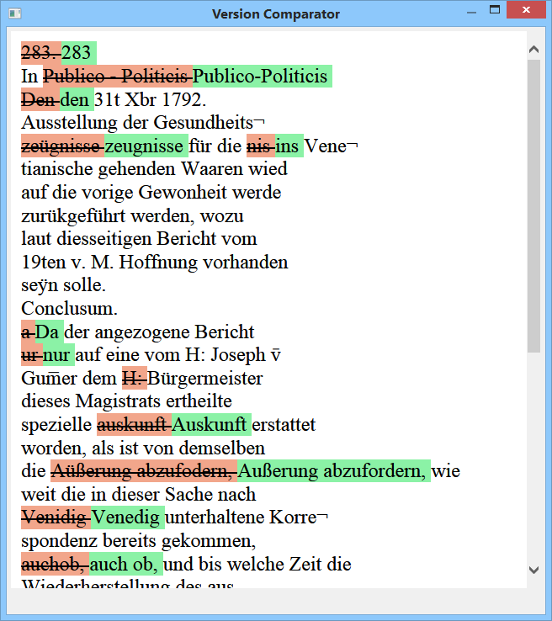

Slide 27
Keyword spotting

Slide 28
Mitterlehner - Moiveshekner

Slide 29
European historical document collections can be recognized, automatically transcribed and made searchable in a previously unknown way – if scholars, archives/libraries, computer scientists and the public are collaborating.

Slide 30
Sustainability

Slide 31
Spin off
How to transform a project into a legal entity?
Which governance model, which business model?
How to sustain the public mission?
How to be flexible and strong enough for the market?
How to enable collaboration?

Slide 33
The European Cooperative Society (SCE)
is a legal entity that allows its members to carry out common activities, while preserving their independence;
its principal object is to satisfy its members' needs and not the return of capital investment;
members benefit proportionally to their profit and not to their capital contribution.

Slide 34
European Cooperative: READ-COOP
Enables us
To collaborate with all kinds of institutions – archives, libraries, universities, research organisations, associations, and even private persons
To include new members (which are also owners) with minimum effort
To carry out business with these members (but also with non-members)
To gain profit from services
To use profit to improve services
To sustain the Transkribus research infrastructure and its public mission
Status
Currently negotiations are ongoing with potential partners
We hope to set up SCE during first half of 2019

Slide 35
READ - EOSC
What we offer
Highly standardized data
Implemented FAIR principles
All services as web-services via REST API
What we would like to see from EOSC
Collaboration – maybe as member of READ-COOP
Storage and computing facilities for processing large amounts of historical documents

Slide 36
Thank you a lot for your attention
More information
https://www.oeaw.ac.at/acdh/
https://read.transkribus.eu/
This project has received funding from the European Union’s
Horizon 2020 research and innovation programme under
grant agreement No 674943.

