Slide 1
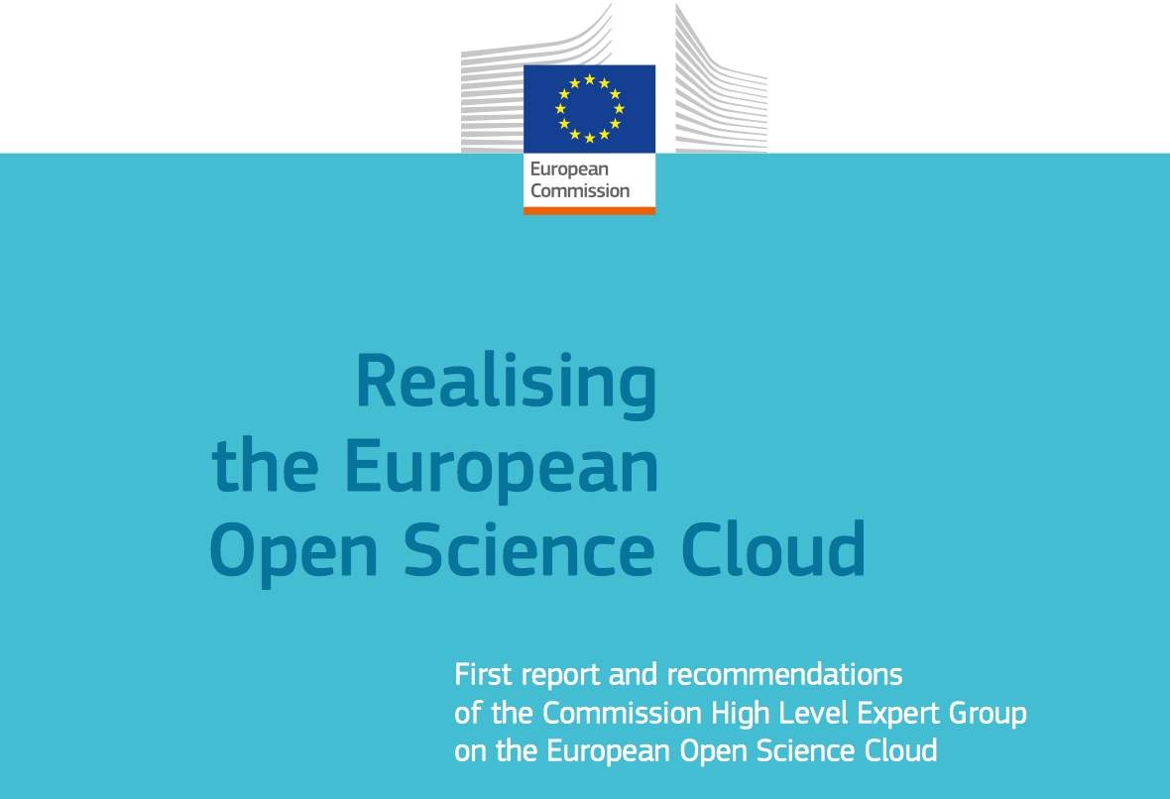
http://ec.europa.eu/research/openscience/index.cfm?pg=open-science-cloud

Slide 2
seven capital sins of open science
keep reactionary reward systems alive
Ignore complexity and the crucial role for machines
Disrespect other disciplines
Publish data and correlations without narrative for people
Publish narrative without machine readable (meta)data
Refuse to fund infra or use research funding tradition for it
Pump data into the environment without the data stewardship plan

Slide 3
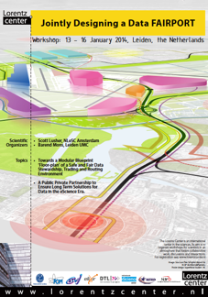
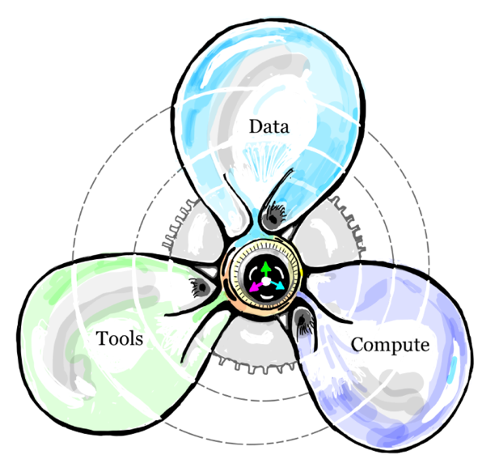
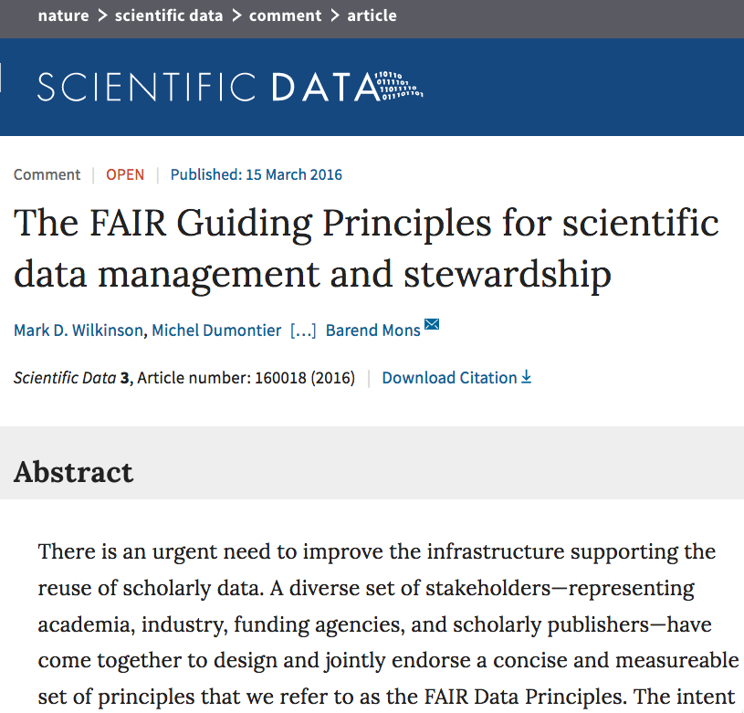
FAIR to IFDS
Lorentz Center
IFDS
Birth
Infancy
Adolescence
Maturity
2014
2015
2016
2017
2018…
Notes:
Brief history of FAIR principles and final goal (1 min)

Slide 4
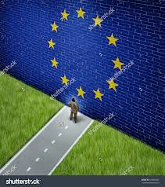
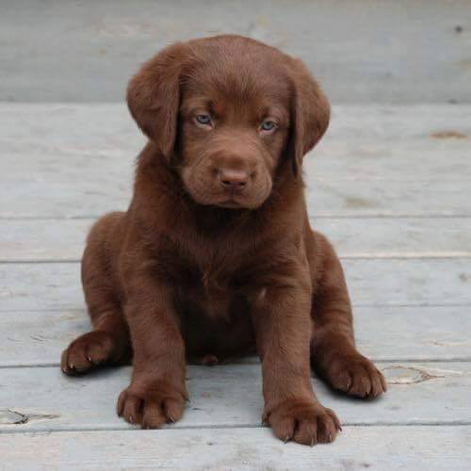
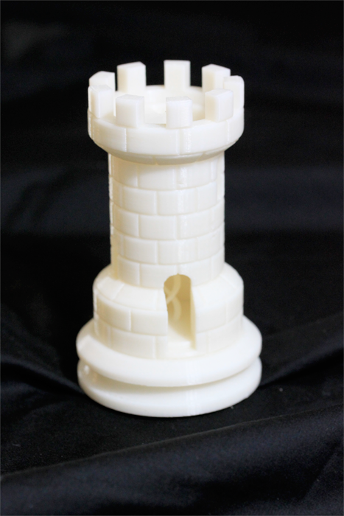
European
Open
Science
Cloud
Cloud
Notes:
Introduction (extremely brief)

Slide 5
=
a bigger ‘me’

Slide 6
What
What is FAIR ?
“Data and services that are
Findable,
Accessible,
Interoperable,
Re-usable
both for machines and
for people.”
The FAIR Guiding Principles for scientific data management and stewardship, Scientific Data (2016), https://www.nature.com/articles/sdata201618
Notes:
just placeholder to tell that FAITR principles will be explained (very needed!) later bij Luiz/erik

Slide 7
What
What FAIR is not …
Cloudy, increasingly FAIR; revisiting the FAIR Data guiding principles for the European Open Science Cloud DOI: 10.3233/ISU-170824
FAIR is not a standard
FAIR is not equal to ‘Semantic Web’
FAIR is not equal to ‘Open’ or ‘Free’
Data are often Open but not FAIR
Data could be Closed yet perfectly FAIR
Many data can never be Open
FAIR principles do not directly proscribe data quality, trustworthiness, ethics or responsibility.

Slide 8
Governance recommendations of the HLEG EOSC (IFDS)
G1: Aim at the lightest possible, internationally effective governance.
G2: Guidance only where guidance is due.
G3: Define Rules of Engagement for formal participation in the EOSC.
G4: Federate the Gems across Member States.
GO FAIR will obviously also honour the P and I recommendations of the HLEG
Notes:
Emphasize GO FAIR follows HLEG(1) recommendations (30 sec)

Slide 9
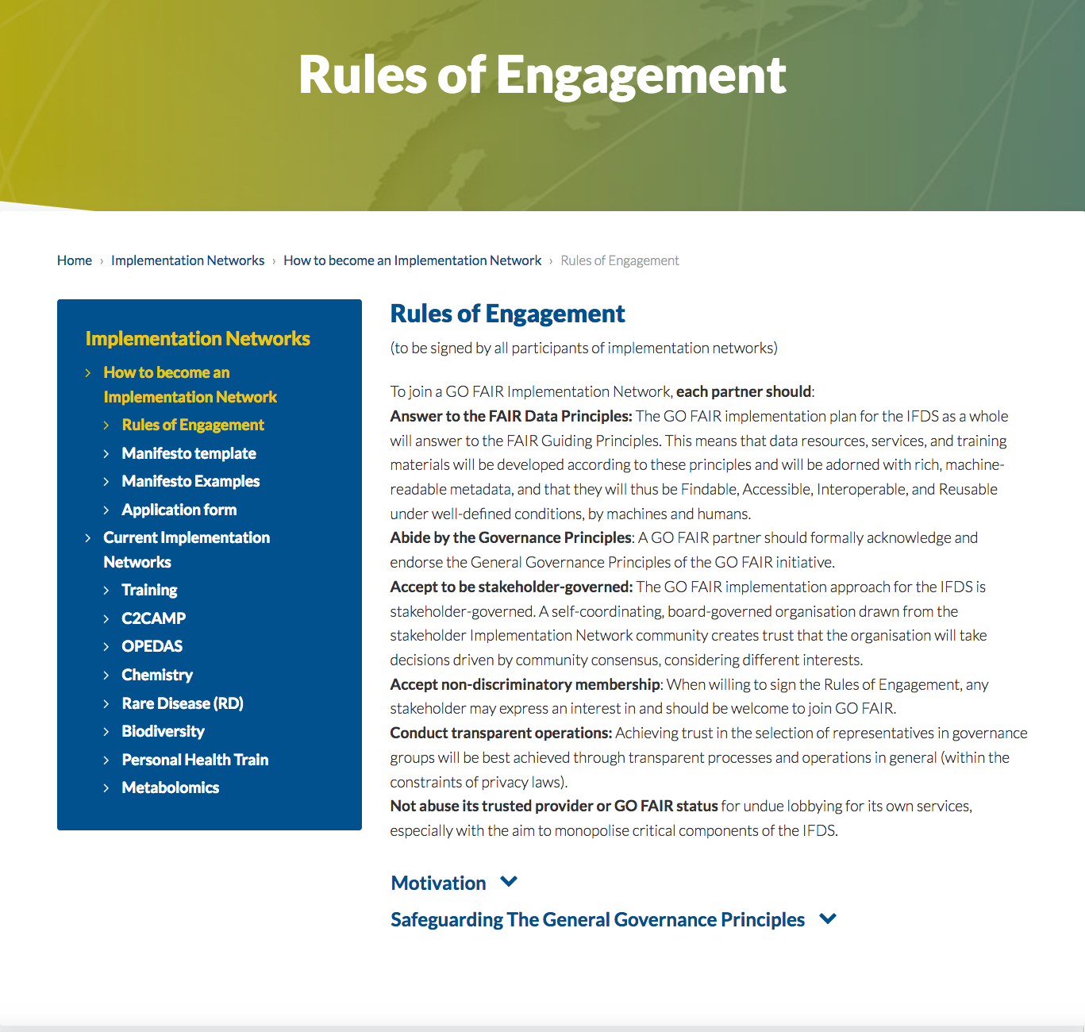

Slide 10
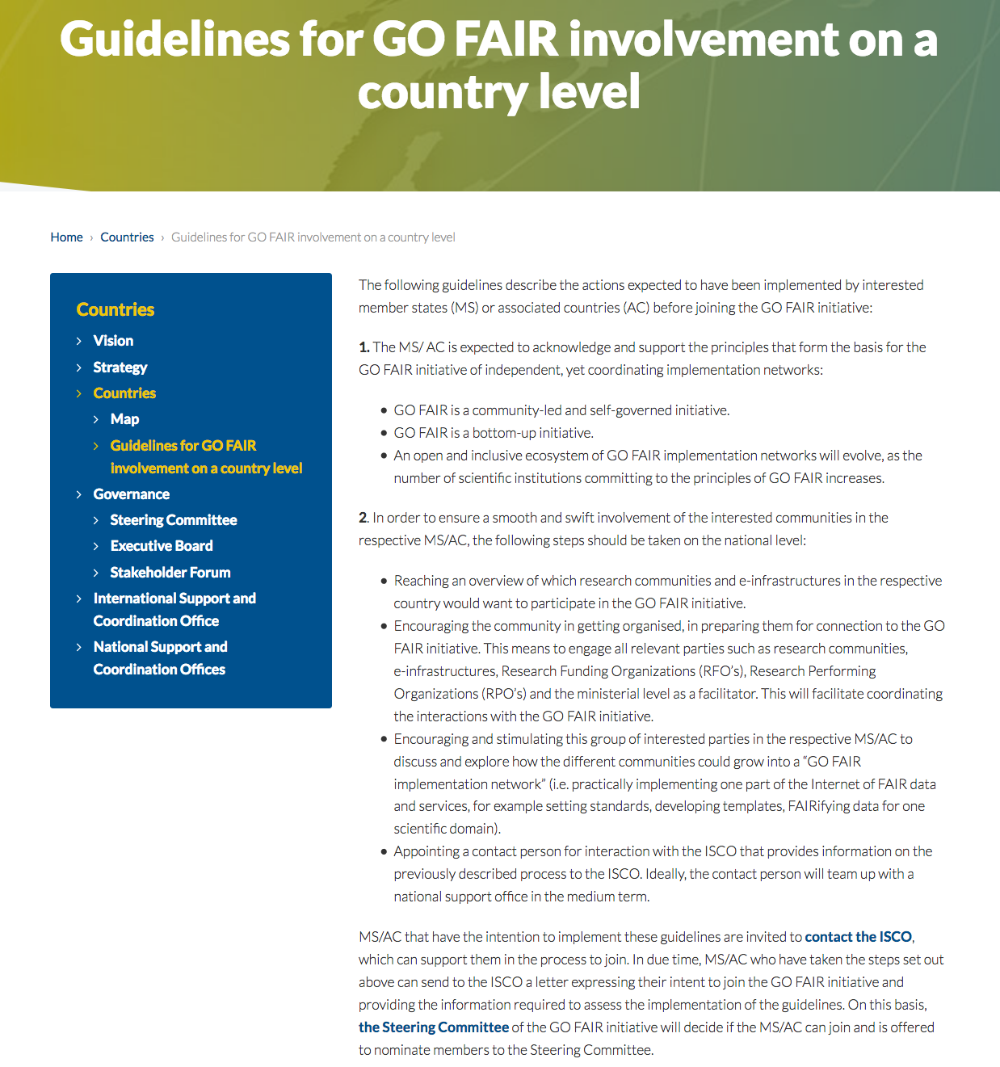

Slide 11
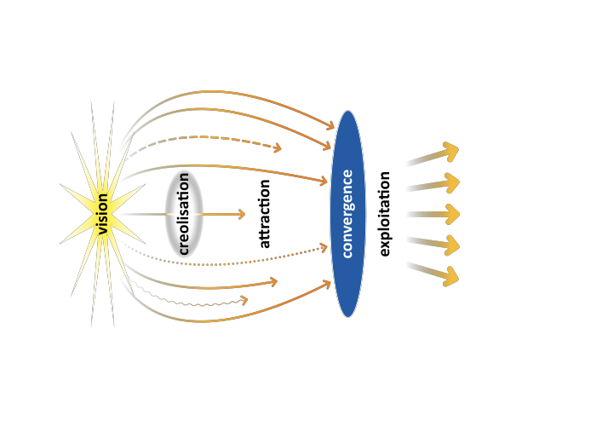
Common Patterns in Revolutionary Infrastructures and Data
Peter Wittenburg, Max Planck Computing and Data Facility, George Strawn, US National Academy of Sciences, February 2018
https://www.rd-alliance.org/sites/default/files/Common_Patterns_in_Revolutionising_Infrastructures-final.pdf
Notes:
1 min (common patters: to place GO FAIR in high level global and ‘tipping point’ context (not at organisational level)

Slide 12
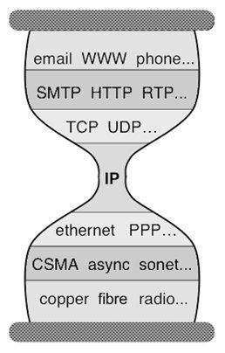
Minimal standards
Voluntary participation
Critical mass
Notes:
1 min: Hourglass model intricuced with three major ‘key features’

Slide 13
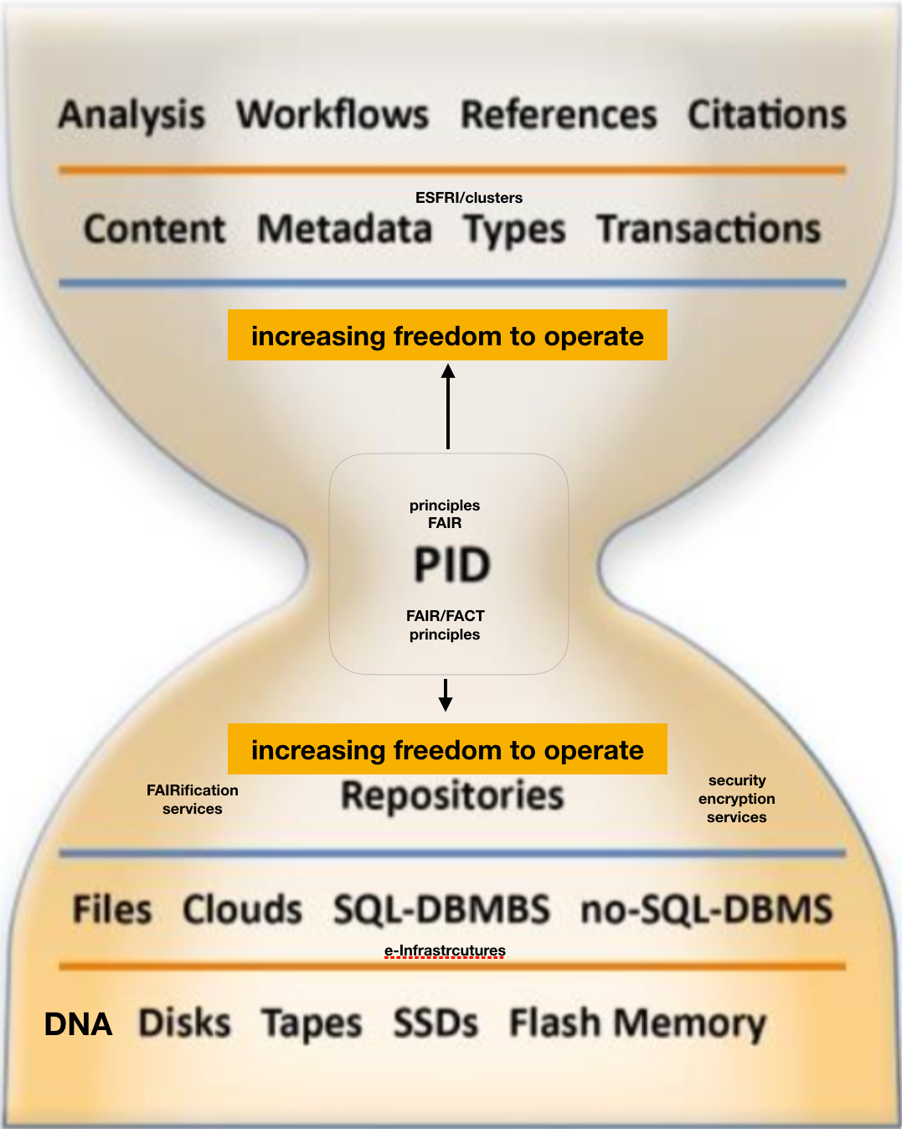
Lessons from the Internet for People:
1. Minimal standards only
2. Rough consensus/Running code
3. Don’t tell anyone else what to do
4. Critical mass of lead-players
Now, for the Internet for Machines
Notes:
1 min.: We repeat this in GO FAIR towards the IFDS/Internet for social machines

Slide 14
?
EOSC (boards + secretariat)
2005
2015
2020
EOSC
FAIR
2018
10/26
Minimal standards
Voluntary participation
Critical mass
Rough consensus and running code
Notes:
1 min: Where we stand today and till 2020
Handover to Luiz

Slide 15
….and to other major international players….?
ISC
200+ councils and societies
Proposed
Best Practices
(standards
protocols etc.)
Proposed
Best Practices
(standards
protocols etc.)
best practices
WG
outcomes
learning
by doing
certification
schemas
e-infra
&domain
partners
Science
Europe
consensus
building &
Design
dovetailing
practical testing &
implementation
7000 + partners
500 + implementation partners
Notes:
GO FAIR versus the other organisations (inserted at the expense of the same presentation -now much shorter- in the afternoon (1 min)

Slide 16
NOT
BUT EOSC
EOSC
IFDS
IFDS
IFDS
Asia, Australia, Africa
EUROPE + AC
North America, South America
Notes:
Broader and smaller: (30 sec)

Slide 17
chemistry
AGU
ASTRON
rare diseases
Vaccines (VISI)
Nano (materials)
GERDI
Sea Data Cloud
Pers. Health Train
NOMAD
Biodiversity (DISSCO)
metrology
metabolomics
Agri/Nut GODAN
Annotate
C2CAMP
CBS-types
OPEDAS
FAIRwizard
Training
∂
distributed learning
∂
∂

Slide 18
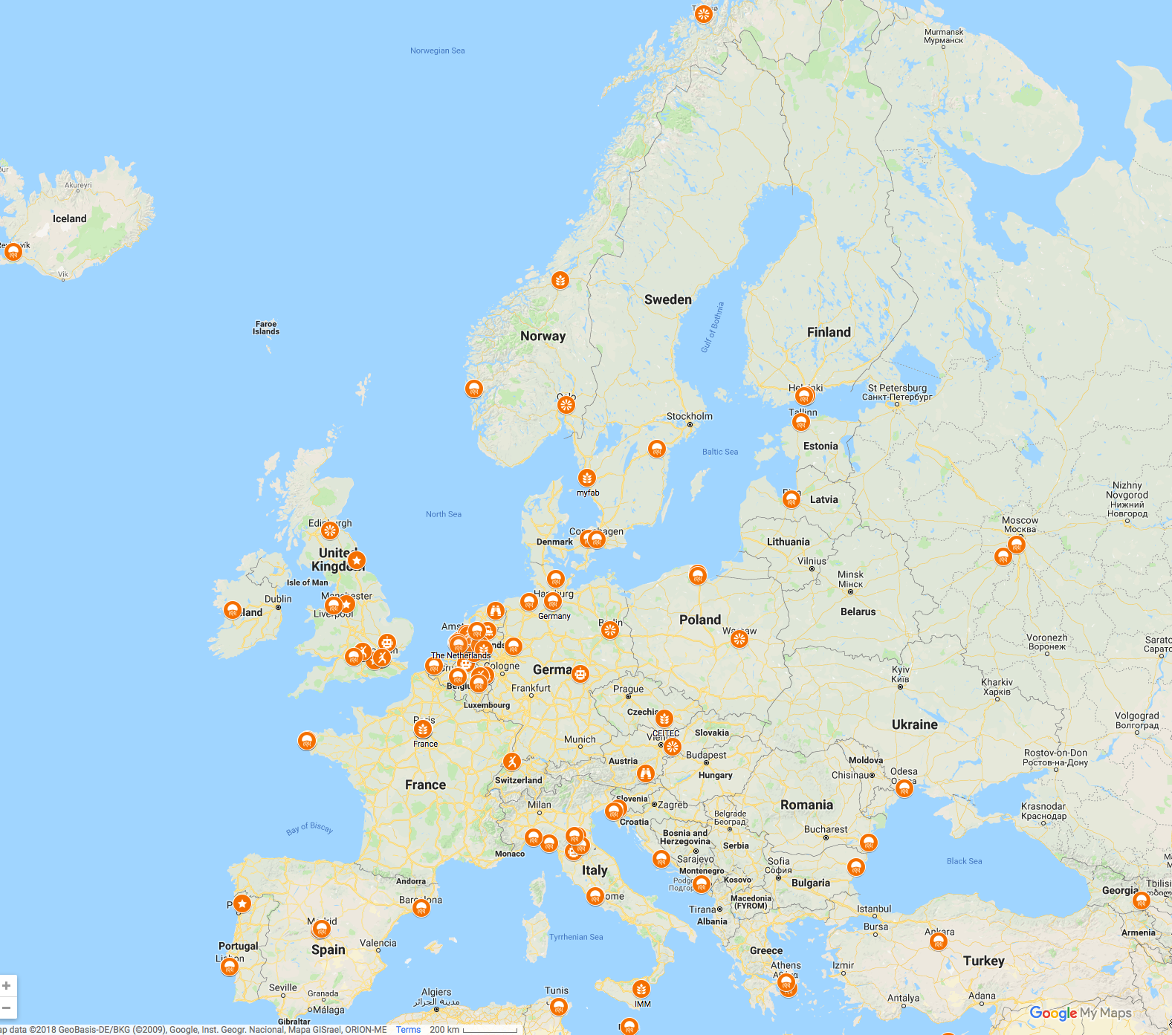

Slide 19
Notes:
Here we have to say something about the GO FAIR foundation and the building relationships with industry. Bert, Albert and Luiz have many more logo’s on slides (for instance related to PHT) and this slide will be replaced by a later version on Thursday
(2 min max)
Bert?

Slide 20
EC proposal for FAIR building blocks
EOSC Council Conclusions
Foster FAIR data
Make optimal use of existing initiatives
Implementation Roadmap
FAIR related actions, milestones and resources
EOSC Declaration
Commitments to change towards FAIR
Data culture and skills
Rewards & incentives
Data tools and services
European Cloud Initiative
Make open research data the default option
FAIR DMPs
Policy context
Demonstrate the financial case
Cost of not having FAIR data
Cost-benefit analysis
Recommendations for sustainability
Support implementation
Turning FAIR data into reality
FAIR data action plan
2018
Policy implementation
Provide guidance
European Research Interoperability Framework
Maximize efficiencies
Annual FAIR data Work Plan
Ensure governance
- FAIR data Working Group
2019
Target groups
Measure readiness
Core assessment criteria
FAIR data maturity model
Promote certification
Accreditation / certification scheme
Policy makers
2020
Funders
Researchers
Infrastructures
Coordination Fora

Slide 21
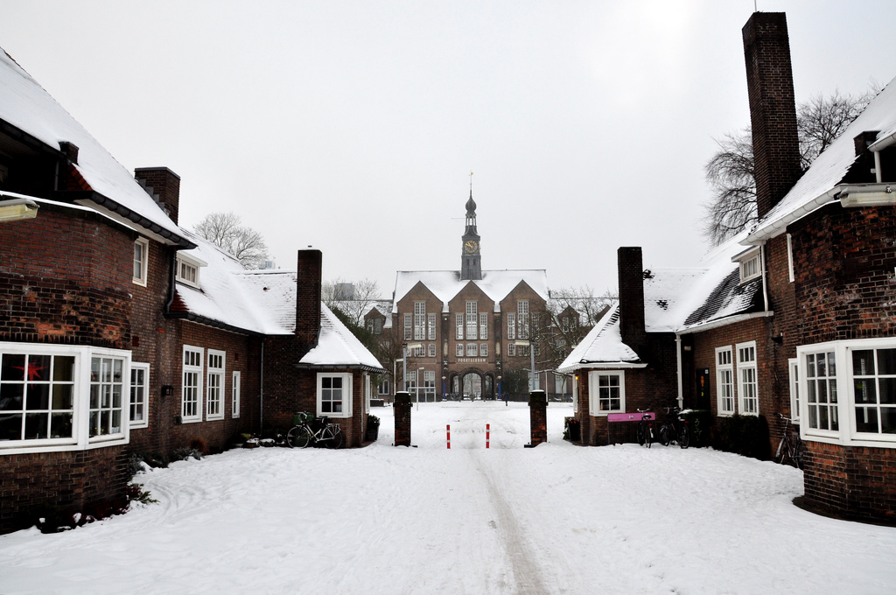
ISCO
Welcome!
Austria Belgium Brazil
China Czech Republic Denmark Greece
Hungary Italy Ireland Kenya Norway Portugal
Slovenia Spain Sweden Switzerland UK USA Zimbabwe

